Slide 1
Achieving a competitive advantage with Power Platform and Microsoft Fabric
Milinda Vitharana
Principal Product Manager
Microsoft Dataverse
Mudit Mittal
Principal Group Eng. Manager
Microsoft Dataverse

Slide 2
Achieving a competitive advantage with Power Platform and Microsoft Fabric
1
What success Looks like in the age of AI…
2
Demo: Power platform integration with Microsoft Fabric
3
Roadmap to kick start your journey

Slide 3




What success looks like to our customers
Opportunity to make use of ever-expanding data estate
2x data by 2026
70% data projects below expectations
43% projects delayed due to skills gap
Power to Question: Asking a question requires days and weeks of data gathering and prep, especially when questions span Apps
Empower your people: Instead of hiring specialists, or getting new tools, how can I enable my people with tools they know and love?
Data integration simplified: I don’t want to become the Chief Data Integration Officer… we want to simplify our data pipelines and get to answers faster
Replicate your success: we have pockets of innovation; how can I replicate success across my organization without starting from scratch?
Notes:
I would like you to focus on Analyst predictions on the right… data volume you have today is going to double in just 3 years. This is indeed good news, digital transformation projects are yielding more data. But are we getting value from that data?
-----------------------------------------------------------
Sources
Data volume is growing at a rapid pace – expected to grow 2x by 2026 (IDC datascape survey 2022)
IDC global IT skills survey (Jun 23): 43% business leaders cite skills shortage as the main concern, delays digital transformation projects by 6~12 months Future of Work: Assessing and Addressing IT Skill Gaps in the Enterprise (idc.com)
By 2022, 50% of organizations will have business-IT collaboration teams driving technology-based business innovation., Predicts 2020: The Future of Application Architecture, Development, Integration and Platforms, 12/5/19

Slide 4


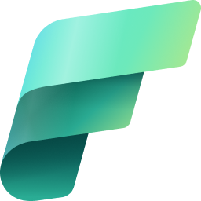
Power Platform and Microsoft Fabric : Better Together
Ask questions, talk to your Apps & data with conversational AI
Repeatable success with enterprise scale and life cycle support for your Low & No code apps
Empower your people to do more with Low code apps and automations
Simplify data integration, securely connect your business data with world’s data
Infuse Low code community with Data analyst, Data wrangler skills
Notes:
We are thrilled to announce the Public preview of integration between Power platform and Microsoft Fabric today.
With Microsoft Fabric integration, your people get new super powers like data wrangling, data analysis…. Also organizations can now build fusion teams with data analysts and data wranglers
This is the Power platform conference, I think you know the super powers you get with Low code apps and automations.
Dataverse is the data platform powering all this, your Low code apps get enterprise scale and life cycle support.
And this morning, you saw how easy it is to include Copilots and conversational AI into your Apps with Power platform – you get to talk to your data and apps – ask questions from your data in Dataverse
Now, dataverse enables direct links to Microsoft Fabic, no data copy, no ETL, no third party tools. So you can connect to worlds data securely. Without the need to build complex data integrations.

Slide 5

Microsoft Dataverse
Enterprise grade low-code, data platform that manages your data and business logic across the cloud
Business Logic
AI + Analytics
Integration
App + Data Lifecycle
Data Storage
Security + Governance
Notes:
How does Dataverse do that?
By understanding the data and its intent, Dataverse provides turnkey capabilities in a consistent manner over all its data.
It’s not just a database or storage, it encompasses everything that is needed to build integrated applications, processes, and insights across the enterprise.
This comes in many forms - from data storage, to APIs and business logic and events, to reporting and analytics and AI, to security and compliance.
And because it is a low-code data platform, developers can spend more time focusing on business needs through the configuration of the system and less time building infrastructure.

Slide 6
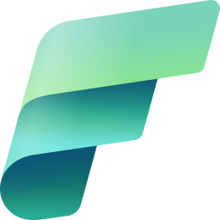


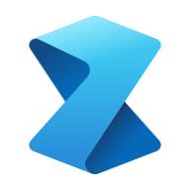


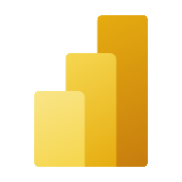
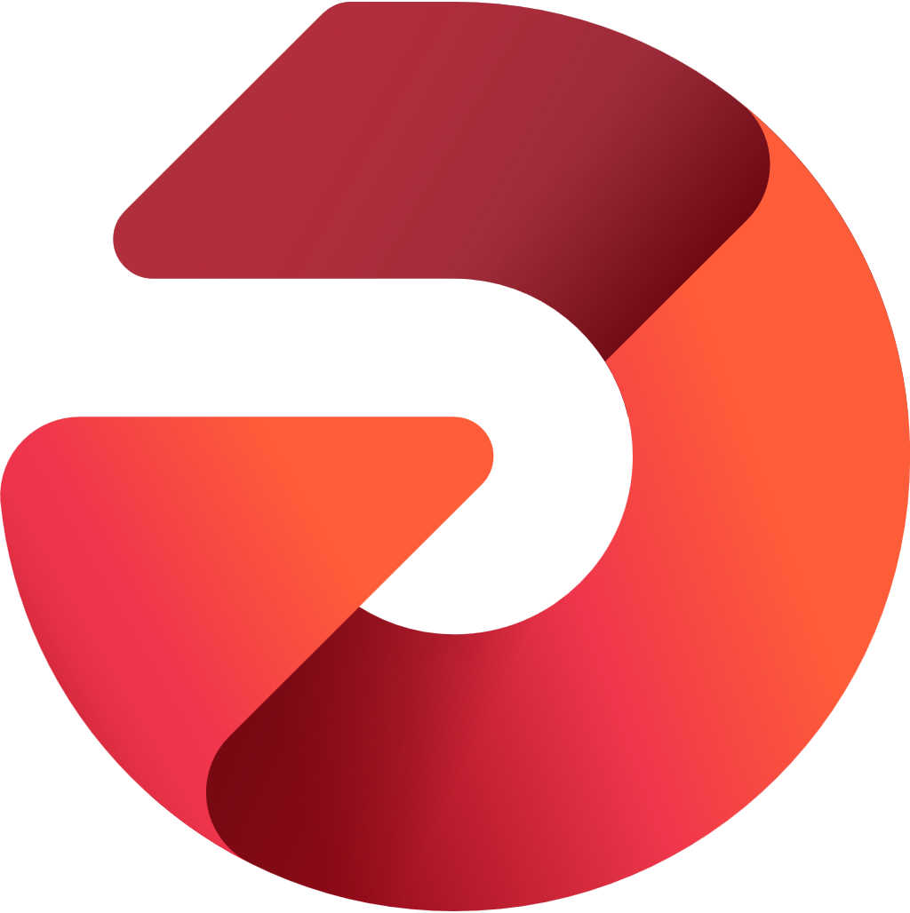

Microsoft Fabric
Data analytics for the era of AI
Data
Factory
Synapse Data
Engineering
Synapse Data
Science
Synapse Data Warehouse
Synapse Real Time Analytics
Power BI
Data Activator
OneLake
Notes:
Transition to Customer video (Say ‘roll video’)

Slide 7
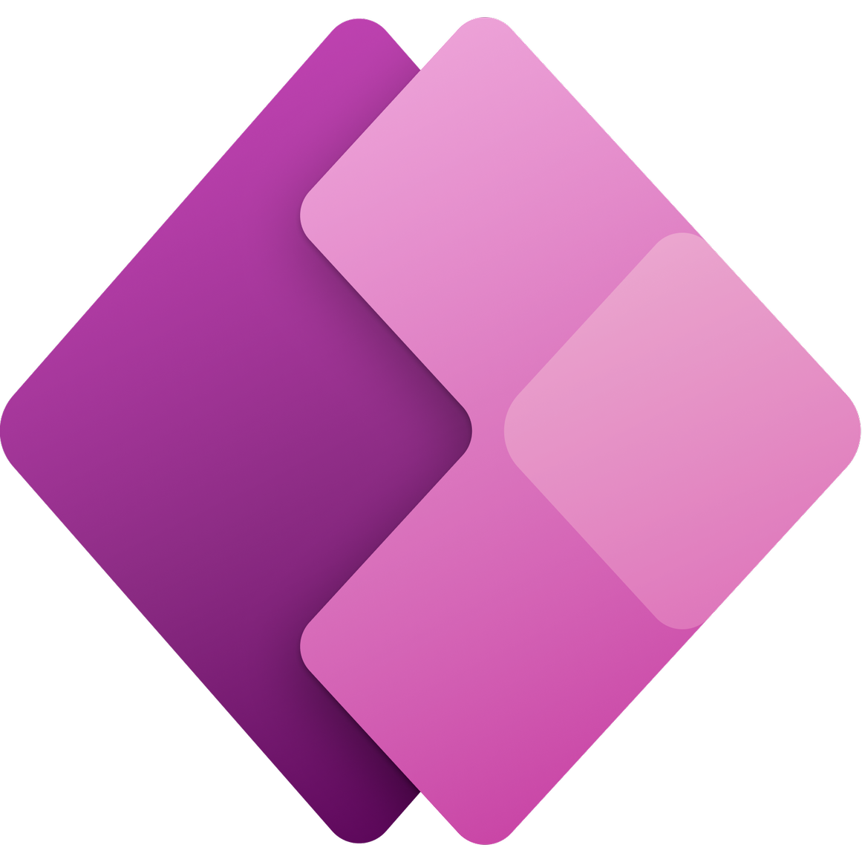
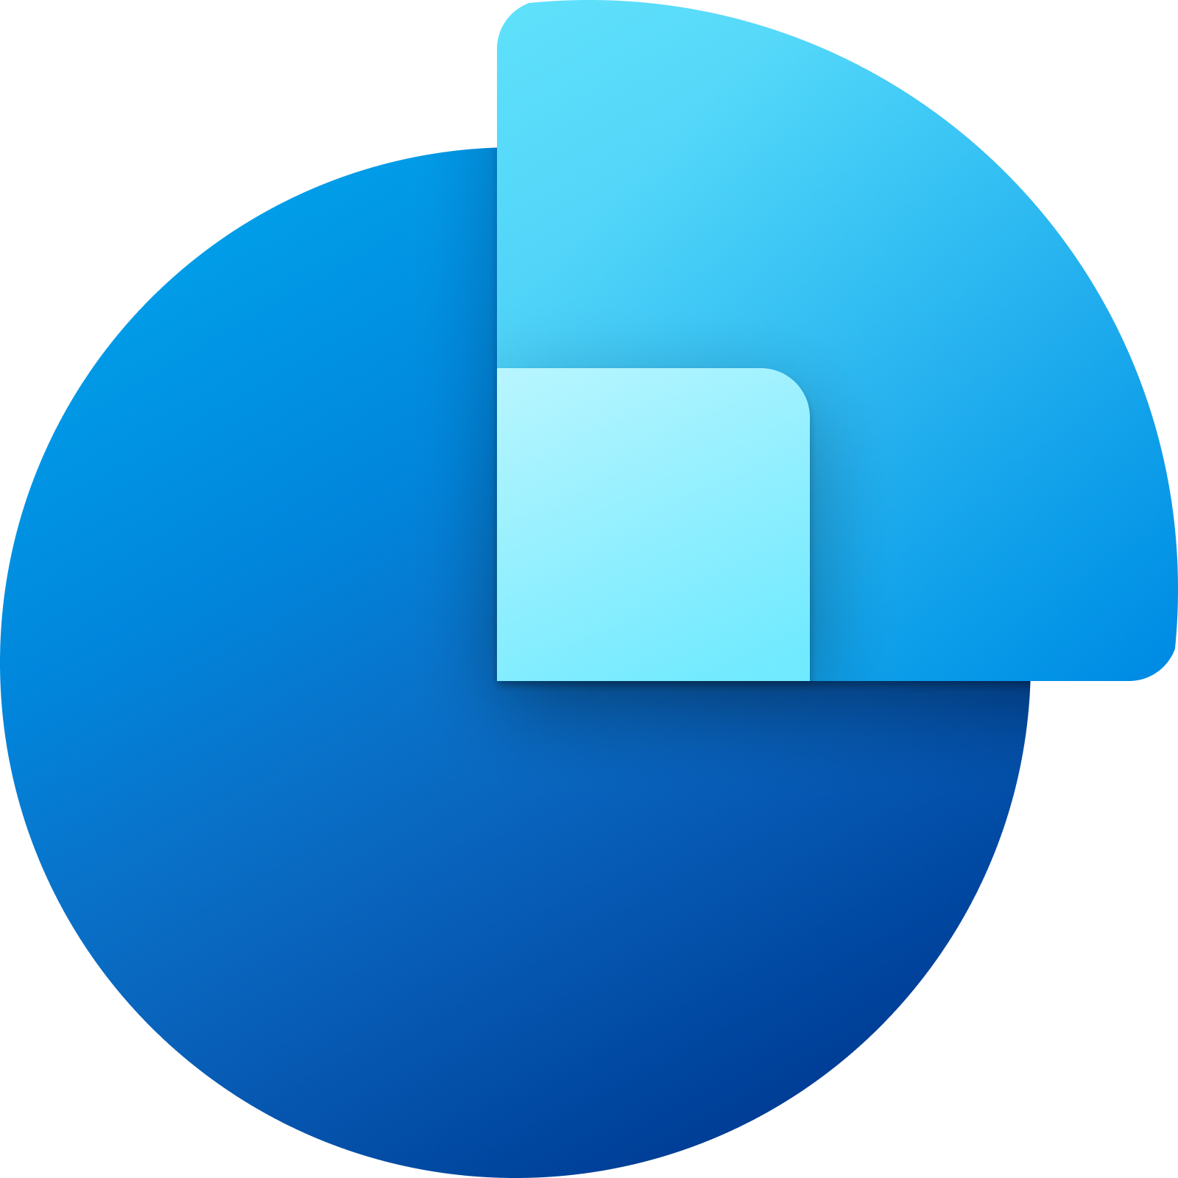


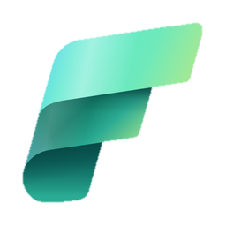

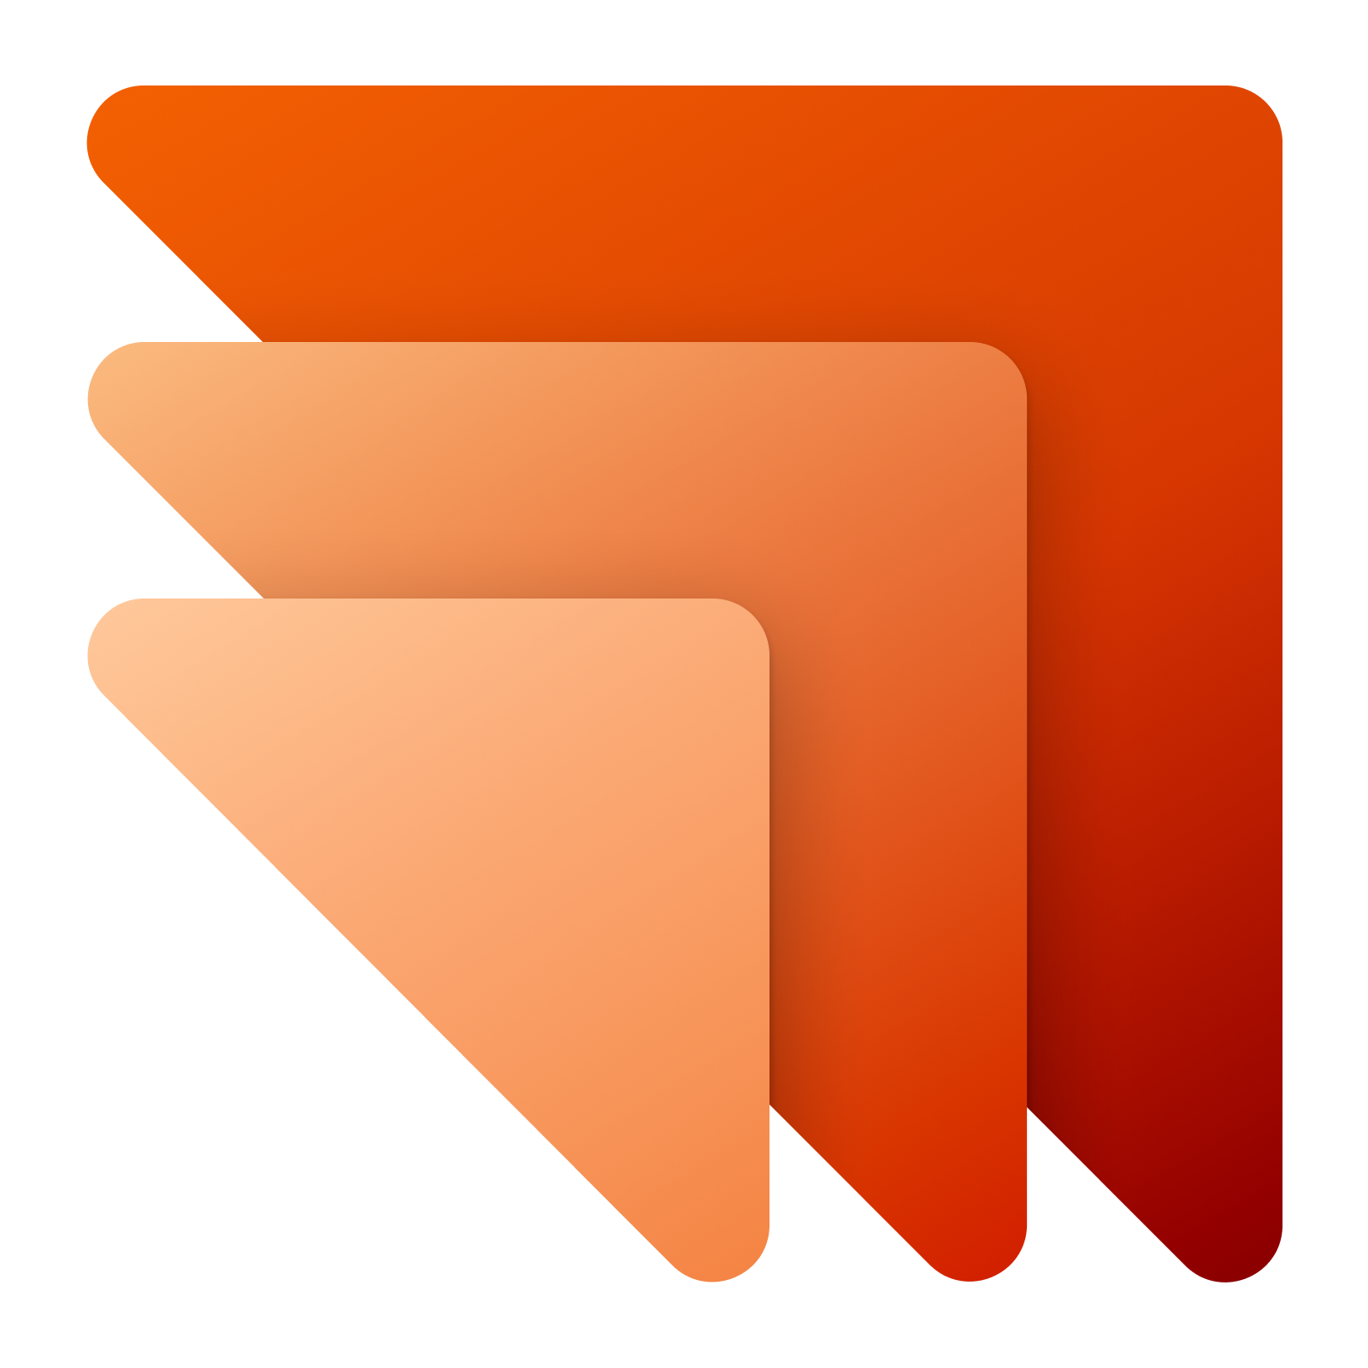


Power platform & Microsoft Fabric
In Public preview
Power Apps
Dynamics 365 Sales
Dynamics & Dataverse data available in Microsoft Fabric immediately, no ETL, no data copy
​
Dynamics 365 Customer Service
Dynamics 365 Field Service
Dataverse
Microsoft Fabric
Microsoft OneLake
Dynamics 365 Marketing
Dynamics 365 Finance & Supply chain
Notes:
If you are using Dynamics or PowerApps, your data is already in Dataverse. With one click, you can work with your data in Microsoft Fabric. Your data is already in OneLake.

Slide 8





Power platform & Microsoft Fabric
In Public preview
Power Apps
Power
Automate
Dynamics & Dataverse data available in Microsoft Fabric immediately, no ETL, no data copy
Makers can build Apps with insights from Microsoft OneLake no ETL, no data copy
​
Power Pages
Power
Virtual agents
Microsoft Fabric
Microsoft OneLake
Dataverse
Power Fx
AI builder
Notes:
You can use Fabric to work with all the worlds data in One Lake. Data engineers can use SQL, apply AI, combine data, re-shape and build summaries. Get insights on all your data.
Those insights are not useful unless you can take action and drive decisions. With a few clicks, your Data in OneLake appears as tables in Dataverse – you can build Low code apps and build automations.

Slide 9
Dataverse and Microsoft Fabric: better together
Mudit Mittal
Principal Group Engineering Manager

Slide 10
Roadmap
Today – Public preview
​
General availability
​
H1 - 2024
​
Data integration simplified
No Copy, No ETL, no need to bring Azure resources
Combine with your data in One Lake. Join and work using SQL and Spark
Upgrade Synapse Links with Fabric
Includes data from Dynamics 365 Finance & Operations
​
Data integration simplified
GA & ready for production use soon
Replicate your success across the organization with application life cycle management
Empower your people with new skills
Easily build Apps and Automations to take action on insights
​
Empower more users in your organization
Dataverse security in Microsoft Fabric
Table relationships and enhanced metadata in Microsoft Fabric
​

Slide 11
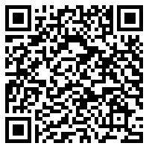
Call to action kick-start your journey today
Join the round table Tue (today), 3PM Room 201/202
Meet us at the expo
Try it yourself https://aka.ms/DataverseExtendstoFabric
Join the community, provide feedback & stay in touch https://aka.ms/SynapseLinkforDynamics
Related sessions
Microsoft OneLake in Fabric, The OneDrvie for Data, Wed, 2PM (155)
Lakehouses, Warehouses and Marts, Oh my … , Wed, 3.15~4.15 (155)

Slide 12
Thank you

Slide 13
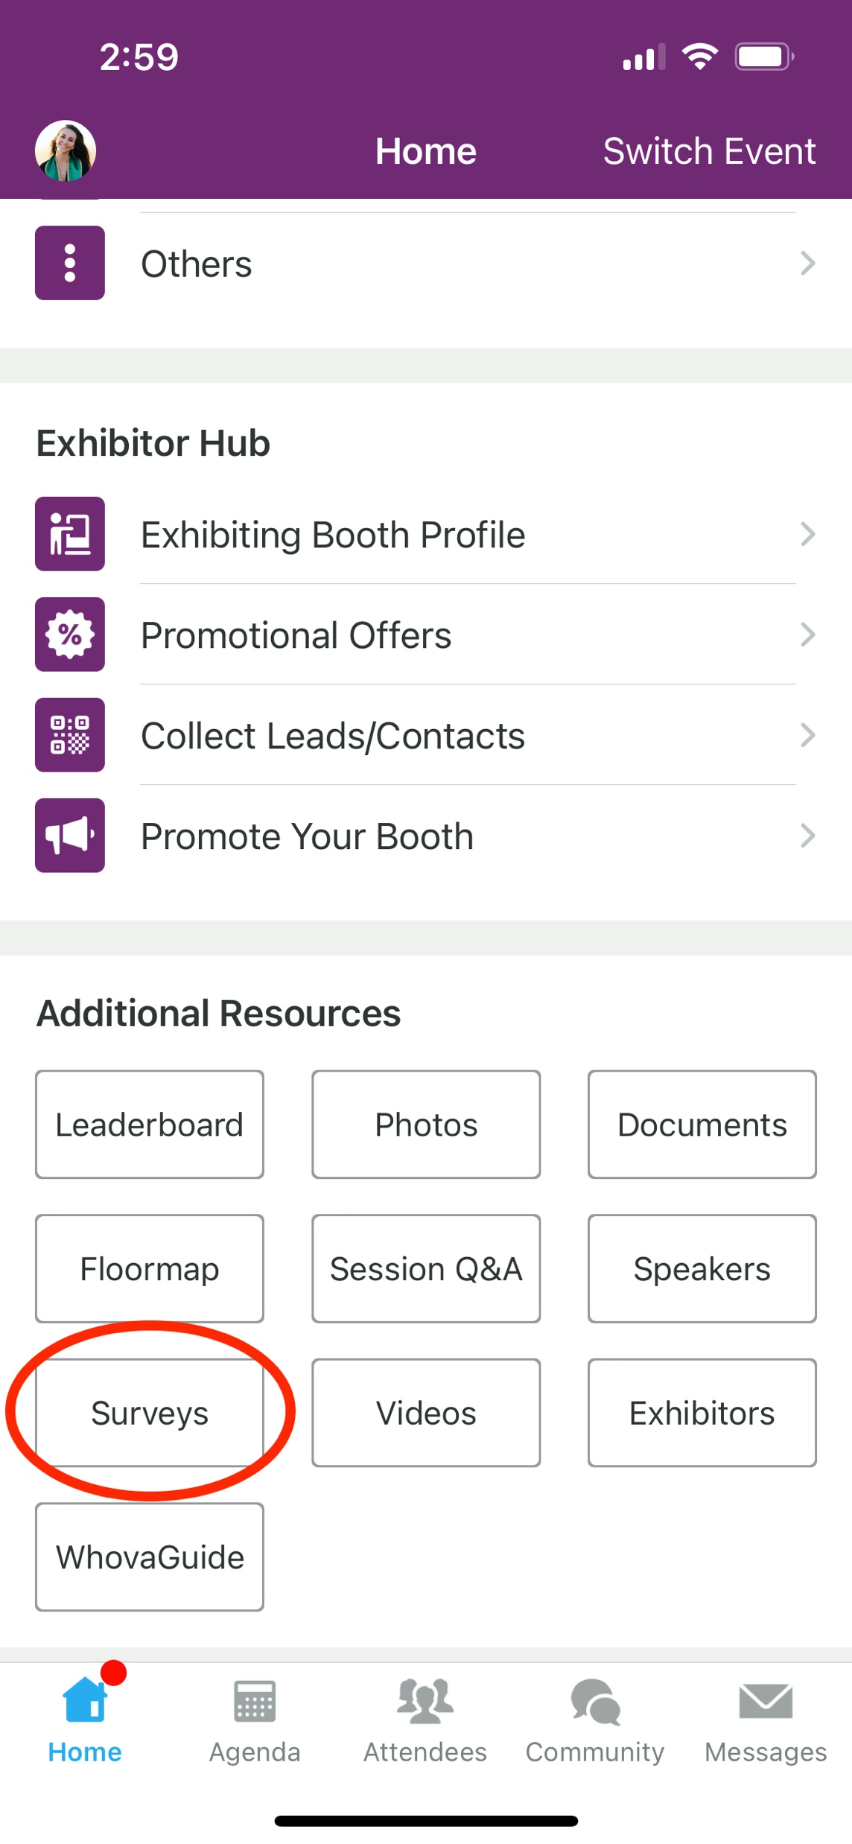
Session Feedback Surveys
We really want to hear from YOU!
In the pursuit of making next year’s Microsoft Power Platform Conference even better, we want to hear your feedback about this session.
Here’s How -
Simply go to the Whova App on your smartphone
Scroll down on the Microsoft Power Platform Conference Homepage to ‘Additional Resources’ to click “Surveys’.
Click Session Feedback.
Scroll down to find this session title.
Complete the session feedback survey.
Finally, click ‘Submit’
It’s just that easy!

Slide 14
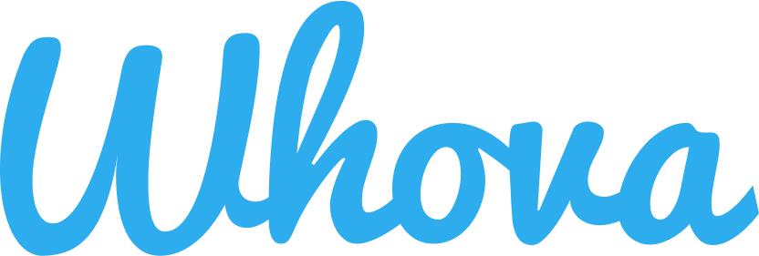
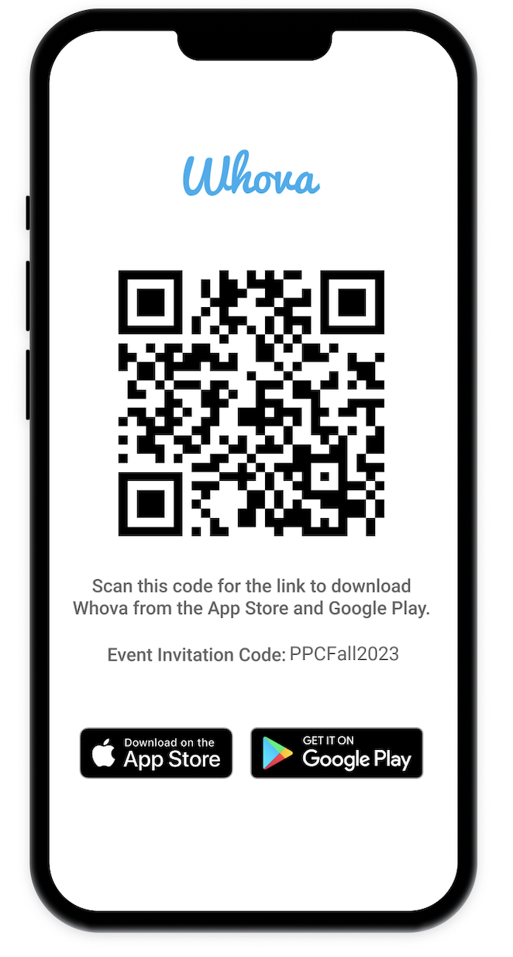
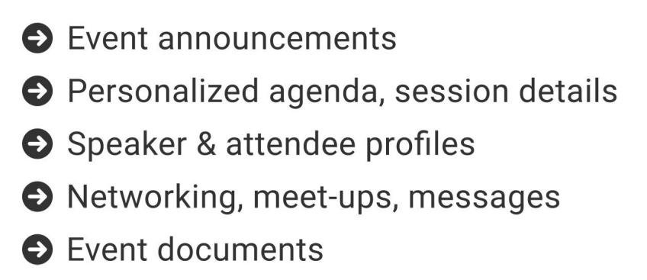
The official event app for the Microsoft Power Platform Conference – Fall 2023
Join the event app to access:
Event Invitation Code: PPCFall2023

Slide 15
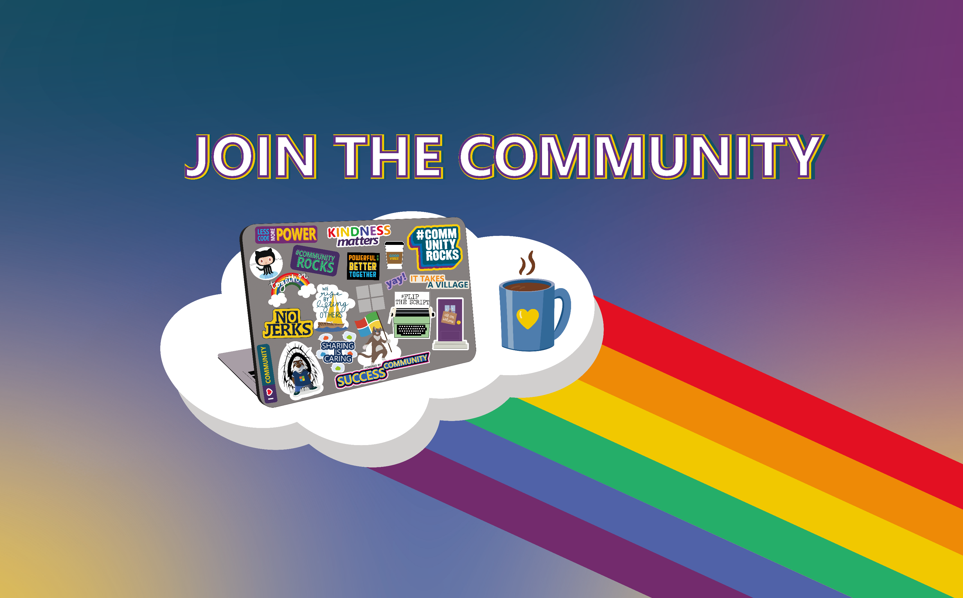
Learn  Explore  Connect
Be a part of the best Community in tech
https://aka.ms/jointhecommunity

Slide 16
Super Users Power Platform Community
Industry experts and the top contributors in the community
Provide solutions in the forums
Blog authors
Video tutorials, tips, and tricks
Moderate the forums
Badge recognition
Monthly Super User Update calls
And MUCH more!
Do you want to become a Super User? Register for our 6 month
Super User In Training initiative at
Aka.ms/SUIT

Slide 17

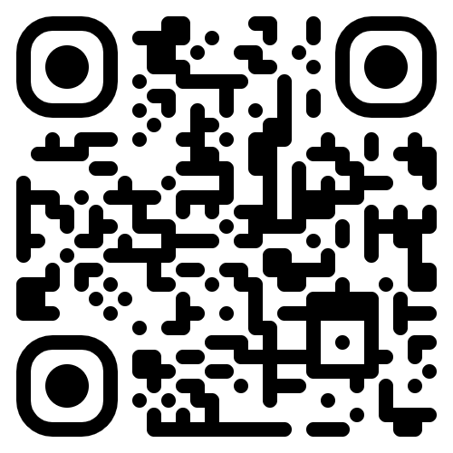
Microsoft
Business Applications
Launch Event
Experience the new era of AI-powered business
Get an in-depth look at the latest AI innovations across Microsoft Dynamics 365 and Microsoft Power Platform at the Microsoft Business Applications Launch Event.
Register now: aka.ms/BizAppsEvent
October 25, 2023 / 9:00 AM–10:30 AM Pacific Time (UTC-7)
Notes:
Hi everyone.
I am Charles Lamanna, corporate vice president of Business Applications and Platforms at Microsoft.
Earlier this month at Microsoft Ignite, I introduced some of the latest capabilities across Microsoft Dynamics 365 and the Microsoft Power Platform in 2022 Release Wave 2.
We have held this launch event twice a year since 2018 and we are proud to continue celebrating the incredible momentum across business applications each year.
As a thought: could we have a stat like "we have been doing these like clockwork since 2018"

Slide 18
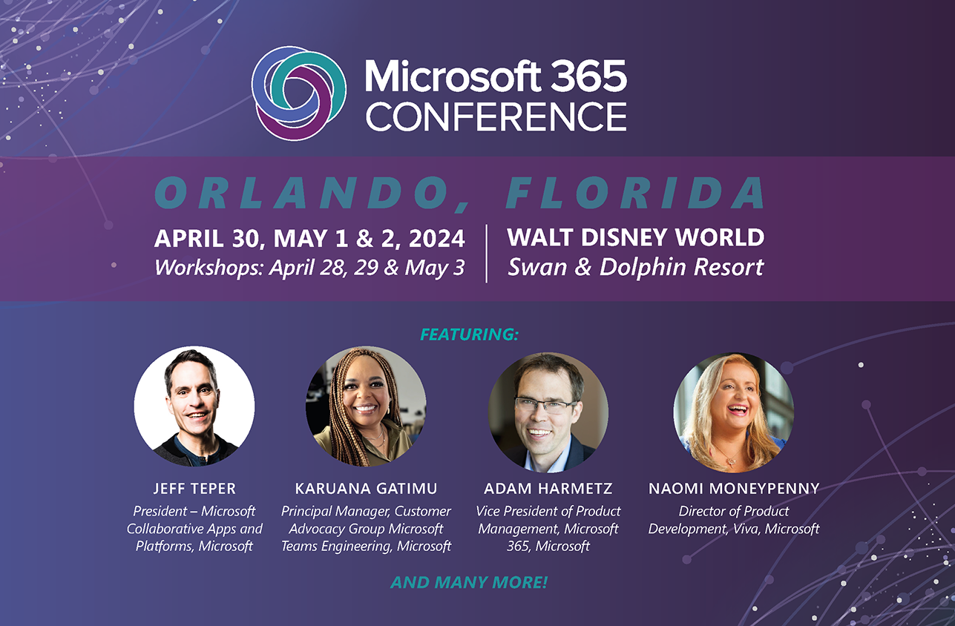

Slide 19
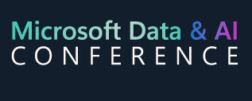
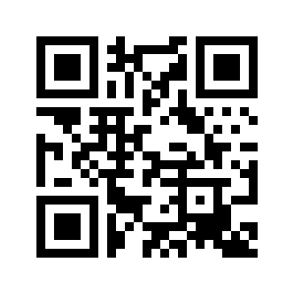
Continue Your Learning
Join us in LAS VEGAS
December 12-14, 2023
Workshops 10, 11 & 15
120+ session on the Microsoft Data and AI Platform
https://aka.ms/mdai
December 12 – 14, 2023
Las Vegas, NV

